Slide 1
Annual Data Survey Results

Slide 2
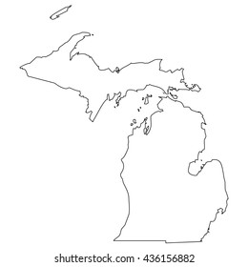
FCOM Data via NAFC Survey
Data requested from 58 MI clinics
36 clinics responded (62%)
Improved response, last year 45%
Annual survey is the only data used to measure our collective impact in Michigan
All data is from 2022 Service Activity
Patients Served, Staff and Volunteer totals are projections based on responses received and represent 58 FCOM members & Associate clinics

Slide 3
Clinic Types
Free Clinics do not charge fees or bill third-party payers (Medicaid, Medicare, etc.)
Hybrid Clinics do not charge patient fees but do bill third party payers (Medicaid)
Student Run Clinics free or charitable clinic housed within a university or school
Charitable Clinics charges patient fees, often sliding fee scale. Does not bill
third-party payers

Slide 4
Clinic Operating Costs
2022 Clinic Operating Budgets
74% of clinics have operating budgets below $250,000
Free Clinics have a BIG IMPACT
with minimal funding!
*43% have budget less than $100,000

Slide 5
Services Provided
 | 95% of clinics offer some RX Assistance
 | 83% of clinics offer Lab Services
 | 82% of clinics offer Health Education
 | 74% of clinics offer Primary Care
 | 63% of clinics offer Mental Health Care
 | 61% of clinics offer Case Management
 | 55% of clinics offer Diabetes Education
 | 53% of clinics offer Specialty Care
 | 44% of clinics offer Vaccinations
 | 44% of clinics offer Vision
 | 41% of clinics offer Dental
 | 41% of clinics offer Dietician/Nutrition
*50% of clinics offer services via Telehealth

Slide 6
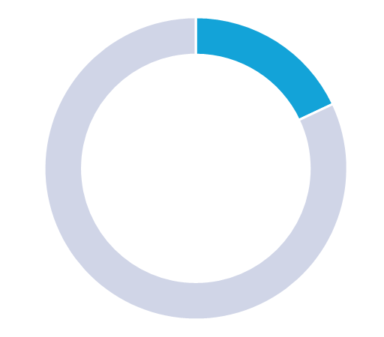
Patients Served
In 2022, Michigan Clinics:
- Served 38,130 individual patients
- Provided 107,097 visits
- Enrolled 14,605 new patients
44%
increase
25% of patients are INSURED
5%
increase
30%
increase
46%
increase
56% of patients are EMPLOYED
*66% of clinics reported an increase in
patient care from previous year
8%
increase

Slide 7
Staff and Volunteers
Free clinics rely on a network of over 5,022 volunteers
1,860 clinical volunteers
+ 3,379 student volunteers
On average, clinics have only 3
paid non-clinical staff members

Slide 8
Top 10 Operational Needs
Clinical Volunteers
Funding Sources
Specialty Care Options
Marketing & PR
Affordable Medications
Instruments & Equipment
Incentives: Gift/Gas Cards
Transportation Assistance
Technology: Computers
Translation Services

Slide 9
Thank You!
Visit FCOM online: fcomi.org facebook.com/Free-Clinics-Of-Michigan

