Slide 1
Annual Data Survey Results

Slide 2
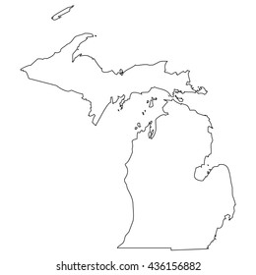
FCOM & NAFC Survey Data
Data requested from 48 MI clinics
27 Clinics responded (56%)
14 sent NAFC survey results
13 filled out FCOM survey
All data is from 2020 Service Activity
Patients Served, Staff and Volunteer totals are projections based on responses received and represent 48 clinics

Slide 3
Clinic Types
Clinic Type Results
Free Clinics do not charge any fees or bill any third-party payers (Medicaid, Medicare, etc.)
Hybrid Clinics do not charge patient fees but do bill third party payers
Other may include charitable clinics that charge a fee, referral orgs, etc.

Slide 4
Clinic Operating Costs
2020 Clinic Budget Results
68% of clinics have operating budgets below $150,000
*22 clinics responded to this question

Slide 5
Services Provided
 | 85% of clinics offer RX Assistance
 | 77% of clinics offer Lab Services
 | 73% of clinics offer Primary Care
 | 65% of clinics offer Health Education
 | 47% of clinics offer Dental
 | 46% of clinics offer Immunizations
 | 42% of clinics offer Mental Healthcare
 | 38% of clinics offer Case Management
 | 38% of clinics offer Women’s Health
 | 35% of clinics offer Vision
 | 27% of clinics offer Physical Therapy
 | 23% of clinics offer Dietician/Nutrition

Slide 6
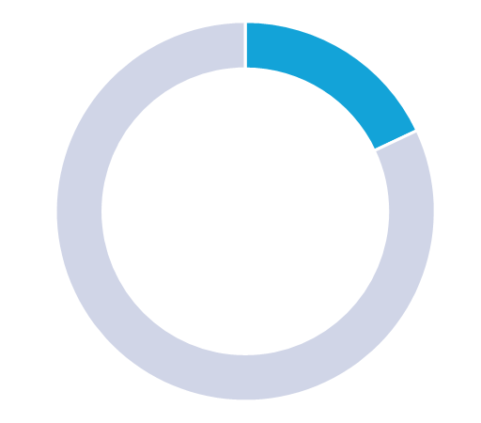
Patients Served
In 2020, Michigan Clinics:
- Served 25,675 individual patients
- Provided 70,092 visits
- Enrolled 6,841 new patients
18% of patients are INSURED
*Half of the clinics reported an increase in
patient care from previous year
- Reported increases ranged from 5% - 40%
47% of patients are EMPLOYED

Slide 7
Staff and Volunteers
Free clinics rely on a network of over 3,800 volunteers
- 2,379 medical volunteers (50/clinic on average)
- 1,439 non-medical volunteers (31/clinic on average)
On average, clinics have only 7 paid staff members

Slide 8
Current Needs
Funding sources
Access to Affordable Medications
Marketing and Public
Relations Resources
Policy & Procedural Guidance
Medical Volunteers

Slide 9
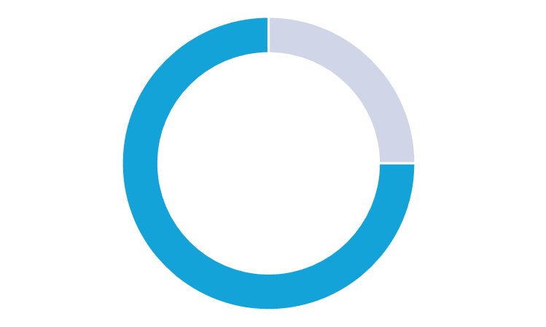
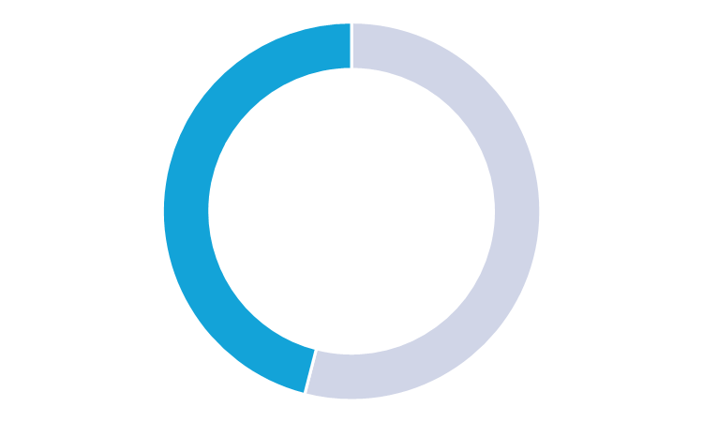
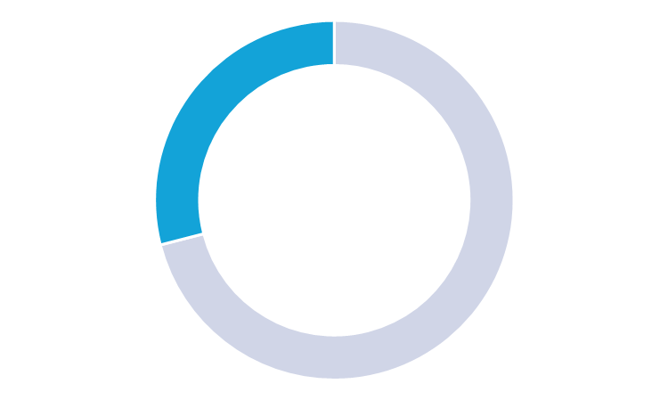
COVID-19
ALL clinics modified operations due to COVID-19
75%
46%
33%
Implemented telehealth/telemedicine services and served patients by appointment only
Suspended walk-in visits
Temporarily closed facilities and suspended services

Slide 10
COVID-19 Cont.
25% of Clinics are providing on-site COVID testing
- over 870 tests administrated
23% of Clinics are providing on-site COVID vaccines
- an additional 23% are interested in adding vaccine availability

Slide 11
Participating Clinics - 5/21/2021
City on a Hill Ministries
Catherine's Health Center
Ferncare Free Clinic
The Fountain Clinic
Dr Gary Burnstein Community Health Clinic
GVSU PT Clinic
Holland Free Health Clinic
Hope House Free Medical Clinic
Hope Medical Clinic
Love in Action of the Tri-Cities
Oasis of Hope
Luke Project 52 Clinic
University of Michigan Student Run Free Clinic
Baxter Community Center
Wyandotte Clinic for the Working Uninsured
Stehouwer Free Clinic
Mel Trotter Ministries
St Peters Free Health Clinic of Hillsdale Co
C-Asist
Malta Dental and Medical Clinic
Kalamazoo Gospel Ministries
Genesee County Free Medical Clinic
Northern Care Center
Tri-County Dental
AuSable Free Clinic
Trinity Community Care
Helen M Nickless Volunteer Clinic
Take the survey if you haven't: https://conta.cc/3bG0I12
Email your NAFC survey to Jeff Compagner:
jcompagner@hfhclinic.org
Visit FCOM online:
www.fcomi.org
www.facebook.com/Free-Clinics-Of-Michigan

